Slide 1
HOUSING DATASET ANALYSIS USING PYTHON
VIJAY G
DADS-MAY’BATCH

Slide 2
INTRODUCTION
To perform data cleaning and preprocessing
To visualize trends and patterns in housing features such as price, location, size, number of rooms, and more
To explore and understand the structure and features of the datase

Slide 3
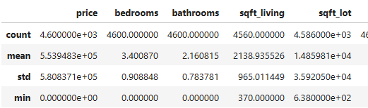
DATA UNDERSTANDING
Grasp the structure, format, and quality of the data
Identify patterns, inconsistencies, and potential errors
Lay the groundwork for cleaning, visualization, and modeling

Slide 4
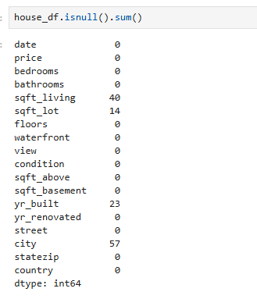
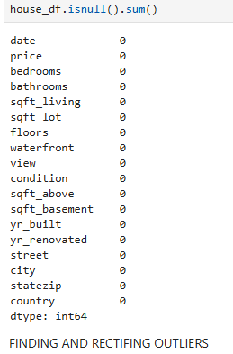
HANDLING MISSING VALUES
Handling missing value analysis in Python typically involves identifying, understanding, and then addressing missing data within a dataset

Slide 5
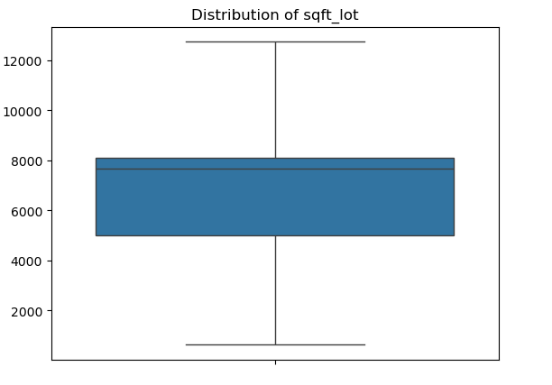
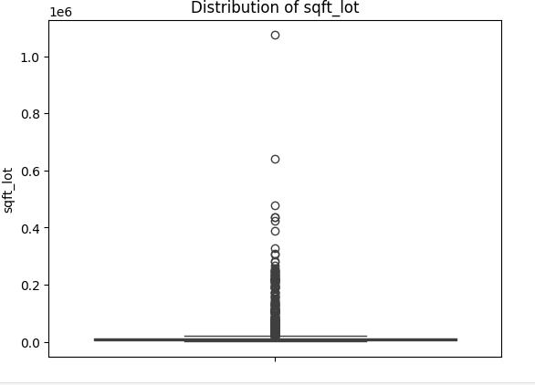
OUTLIER HANDLING
Outlier data is a datapoint that differ from the rest of datapoint
Box plots are a great way to visualize and identify outliers in a dataset

Slide 6
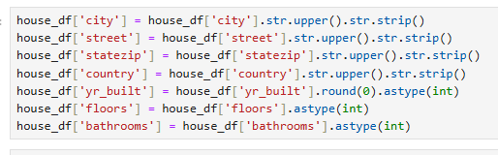
HANDLING INVALID VALUES
Clean and standardize housing dataset by formatting text fields and converting numeric columns to integers.

Slide 7
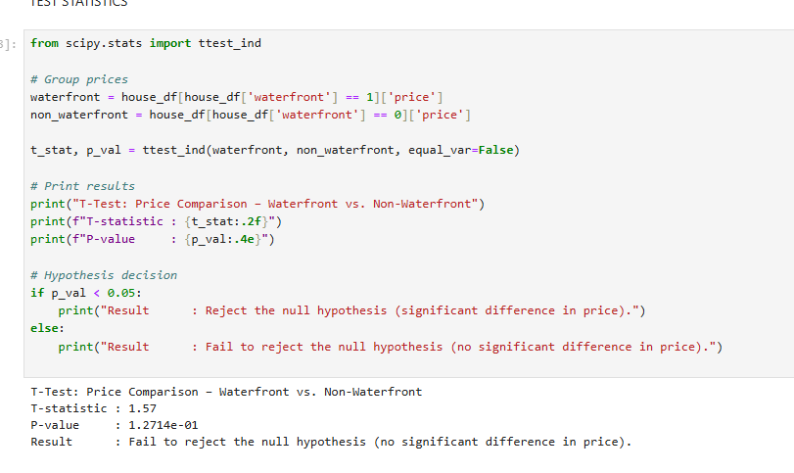
STATISTICAL ANALYSIS
Standardized text fields by uppercasing and stripping whitespace. Converted year built, floors, and bathrooms to integer types for accurate statistical analysis

Slide 8
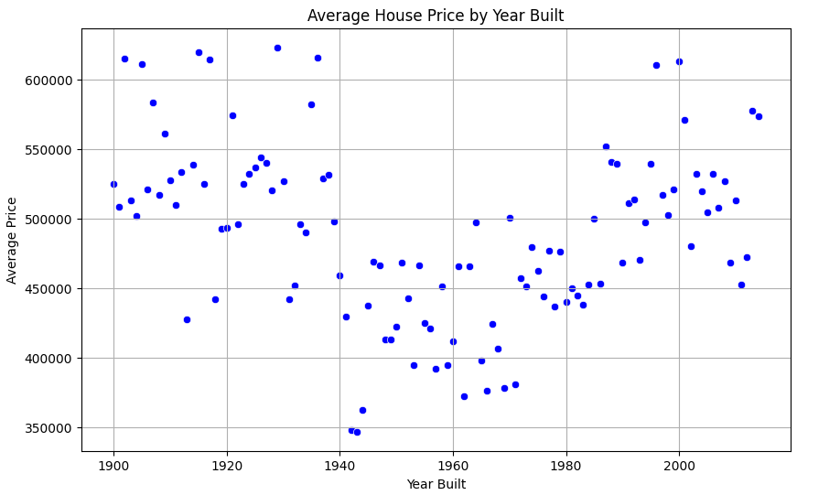
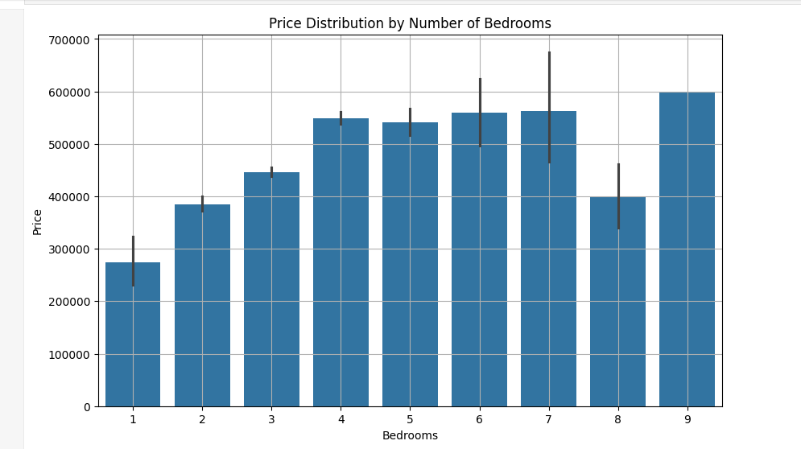
DATA VISUALIZATION
Data visualization in Python involves the graphical representation of data to facilitate understanding, identify patterns, trends, and outliers, and communicate insights effectively.

Slide 9
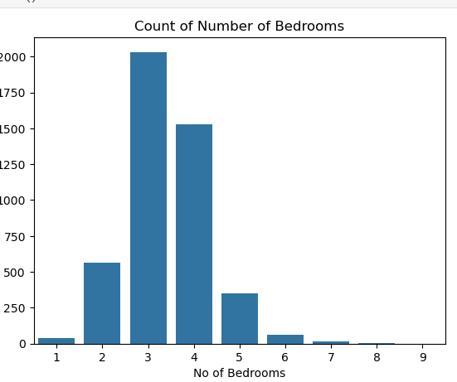
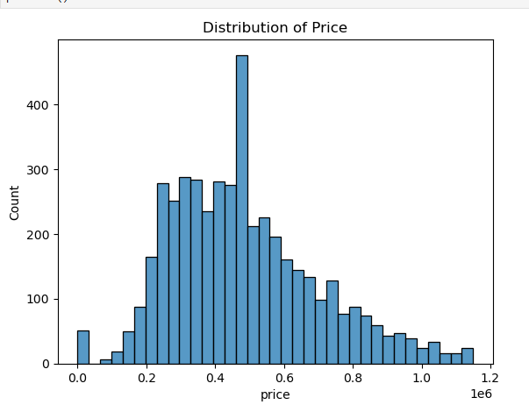
UNIVARIATE ANALYSIS
Univariate analysis in Python involves examining and summarizing a single variable within a dataset to understand its distribution, central tendency, and spread

Slide 10
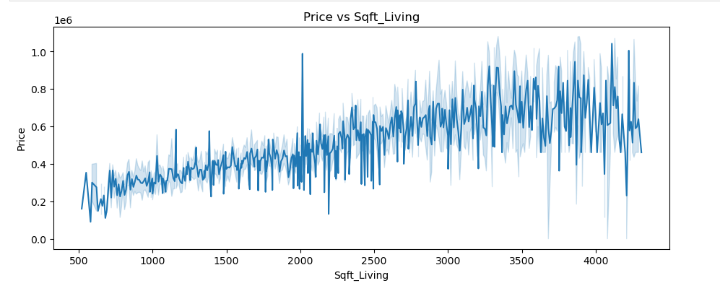
BIVARIATE ANALYSIS
Bivariate analysis in Python involves examining the relationship between two variables to understand their association, correlation, or differences.

Slide 11
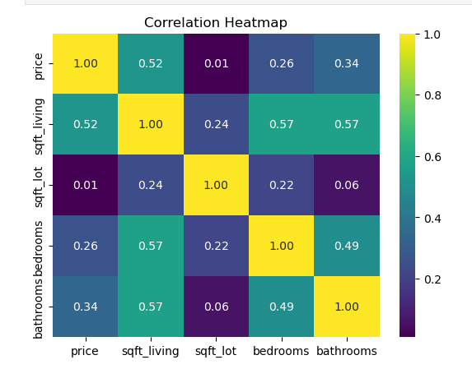
MULTIVARIATE ANALYSIS
Multivariate analysis in Python involves using libraries and techniques to analyze datasets with multiple variables simultaneously, exploring relationships and patterns that might not be evident in univariate or bivariate analyses.

Slide 12
CONCLUSION INSIGHTS
Size, location, and renovation are primary drivers of housing value.
Data-driven pricing strategies recommended for investment success.
Renovate and upgrade for increased value.
Prioritize properties in prime locations.
Future Work: Further modeling and time-trend analysis

